Slide 1
TC Renovation

Slide 2
Summary
Organizing test data
Test Case critical issues
Vague
Knowledge Silo’s (hidden)
Requirements gaps
Writing style issues (hidden)
Gaps in test coverage
QA Training & Common language
Workshop
Things that have helped me

Slide 3
What is a Test Case
What does it need to have

Slide 4
Test Case Format / Management
Test case ID: Unique ID for each test case.
Test priority (Low/Medium/High):
Test Title/Name: Test case title.
Test Summary/Description: Describe test objective in brief.
Test Steps: List all test execution steps
Test Data: Use of test data as an input for this test case.
Expected Result: What should be the system output after test execution?
Status (Pass/Fail):

Slide 5
Test Case Format / Management - Essential Format
Test case ID: Unique ID for each test case.
Test priority (Low/Medium/High):
Test Title/Name: Test case title.
Test Summary/Description: Describe test objective in brief.
Test Steps: List all test execution steps
Test Data: Use of test data as an input for this test case.
Expected Result: What should be the system output after test execution?
Status (Pass/Fail):
There are other things worth tracking

Slide 6
Test Case Format / Management
Designed By: Designed Date: Test Executed By: Test Execution Date:
Pre-condition: Dependencies: Post-condition:
Actual result: Actual test result should be filled after test execution. Describe system behavior after test execution.
Notes/Comments/Questions: makes a huge difference to have good documentation easily accessible
Defect ID/Link: If test status is fail, then include the link to defect log or mention the defect number.
Test Type(s) Keyword(s): functional, usability, Smoke, “Production only”, “Stage only”
Requirements: Link to Requirements doc or listing of exact section
Attachments/References: Screen shots! A picture is worth a thousand words (though it can take a while to make) Diagrams!
Automation? (Yes/No): In many agile shops the set of automation TC will be growing & changing

Slide 7
Test Case Format / Management
Designed By: Designed Date: Test Executed By: Test Execution Date:
Pre-condition: Dependencies: Post-condition:
Actual result: Actual test result should be filled after test execution. Describe system behavior after test execution.
Notes/Comments/Questions: makes a huge difference to have good documentation easily accessible
Defect ID/Link: If test status is fail, then include the link to defect log or mention the defect number.
Test Type(s) Keyword(s): functional, usability, Smoke, “Production only”, “Stage only”
Requirements: Link to Requirements doc or listing of exact section
Attachments/References: Screen shots! A picture is worth a thousand words (though it can take a while to make) Diagrams!
Automation? (Yes/No): In many agile shops the set of automation TC will be growing & changing
Can be hard to see need for additional information until you have
Multiple QA
Thousands of test cases
Automation producing lots of results
Several rounds of testing
Need for transparency

Slide 8
Test Case Format / Management

Slide 9
Test Case Format / Management - many options
Test Case management (rather than google sheet, doc, word doc, etc)

Slide 10
Test Case Format / Management - Starting Point

Slide 11
Test Case Format / Management
Time effective solution: Test Case Management ASAP
Budget & Use Jira
Starting point: Zephyr or X-ray
No budget: use
Has all basic functionality
Fairly popular
Setup & maintenance in a few hours a month
Transparency, metrics, tracking
Data organization, access
TC Management system

Slide 12
Test Case Management
Coordinate results from multiple sources
Encourages good practice
Format (steps, allows for images, etc)
Organization
Questions on Test Case Management?

Slide 13
Common problems & solutions!
Vague
E.g. “Verify page looks correct”””
Knowledge Silo’s
I’ve tested XYX for years,
New QA couldn’t run TC w/o my knowhow
Requirements gaps

Slide 14
Vague TC example
Is this a
Knowledge Silo?
Can we trace it to a requirements gap?
Both?
Can we know?
Who here knows what ACR catalog should be?

Slide 15
Sorting out Vague TC - Why?
Vague TC could be
Silo: information just one person knows
Could be Req gap
Silo QA is a bottleneck & single pt of failure
Speed bump for automation

Slide 16
Sorting out Vague TC - Why?
Vague TC could be silo, could be Req gap
Lead QA / manager: liability
We don’t know until we work through
We don’t know problems with TC until we fix

Slide 17
Sorting out Vague TC - Why?
Silo QA is a bottleneck & single pt of failure
Splitting TC not easy
Speed bump and potential problem If QA
Leaves
Gets promoted
Wants to work on anything else…
Medical or FMLA

Slide 18
Fresh perspective = Million dollar perspective
Someone who does not know the system
Intern
New Hire
Documenting each question
Getting explanations for every question
Motivated

Slide 19
Sorting out Vague TC - Why?
Vague TC are a huge speed bump for automation
100 clear TC with full information
I have to get a clarification on each

Slide 20
Sorting out Vague TC - how to
Peer review / proofread
Development practice
Concept is universal Agile to
All new TC get reviewed by another QA
Intern / new hire review

Slide 21
Sorting out Vague TC & TC Management
TC management
Gives easy to fill & read template
Format & resource linking to make vauge TC clear
Excel
Pushes QA to use shorthand
Discourages review by being less accessible

Slide 22
Recap
Organization: Test Case management
Talked about Vague TC

Slide 23
Writing style:
Hidden weak points

Slide 24
Writing style - Hidden weak point
Jargon
Vendetta commenting
Wordy

Slide 25
Writing style - Hidden weak point: Acronym
Jargon
Acronym Go to AM site, verify PR & COD link in likes.
Any name for something not labeled on the product, the “user screen”
Who can think of a problem with acronyms?
Even when everyone on our team knows them?

Slide 26
Writing style - Hidden weak point: Acronym
Acronym
Go to AM site, verify PR & COD link in likes.
Need to have a wiki if we use jargon / acronyms

Slide 27
Writing style - Vendetta commenting
Requirement | Steps | Verify | Result | Comment
Non-Member RG15 Submission OK | Login as nonmember (RG15 type). Click Today's Cases Click pic / pencil / subspec Click Enter Diagnosis. Enter text Click Submit | Verify: Modal: "Your diagnosis has been saved" |  | (AF 1/25): Per Dan, we only need to login as a non-member and submit 1 case just to ensure that non-members can submit. Do not need to go through all the special characters for a non-member. Special characters tests covered below, and are not specific to an RG type. (DL 2/14) OK

Slide 28
Writing style - Vendetta commenting
Requirement | Steps | Verify | Result | Comment
Non-Member RG15 Submission OK | Login as nonmember (RG15 type). Click Today's Cases Click pic / pencil / subspec Click Enter Diagnosis. Enter text Click Submit | Verify: Modal: "Your diagnosis has been saved" |  | (AB 1/25): Per Dan, we only need to login as a non-member and submit 1 case just to ensure that non-members can submit. Do not need to go through all the special characters for a non-member. Special characters tests covered below, and are not specific to an RG type. (KB 2/14) OK
Talking in the comments rather than
Talking
Updating TC
Solution: meet, propose update

Slide 29
Writing style - Wordy
Wordier test cases mean
Take longer to read
Take more mental energy to read
Increase chance they will be skimmed
Questions on Test Case Management

Slide 30
Bullet point format
Review by Someone who doesn't know product
Intern
New Hire
For writing and reviewing test cases it is good to have a review of someone who is unfamiliar with the product that is being tested. Two examples of roles that bring this perspective to the table are new hires, and interns.

Slide 31
Writing style - minimal format
Wordier test cases mean
Take longer to read
Take more mental energy to read
Increase chance they will be skimmed
Questions

Slide 32
Writing style
Best practice / Policy doc
Test cases should be written with minimum words to clearly and completely describe the test
If a new QA wouldn’t know a term, put it the wiki
Responsibilities of a QA lead
What a Jira bug should have… etc (link, screen shot, etc)
L Little Quizzes with prizes have worked wonders for my teams

Slide 33
Adopting Good Writing Style
Code reviews
As a Mgr-lead once-through your TC
Have QA TC reviews like Dev does Code reviews

Slide 34
Questions?

Slide 35
Test Coverage

Slide 36
Test Coverage
Requirements Coverage:
Structural Coverage:Has each element of the software been exercised?
Architectural Coverage:Have control & data links been utilised?
Some companies use matrix to link requirements to TC
Without diving into what could be a long topic, we’ll cover 3
Two time effective approaches

Slide 37
Test Coverage
Time effective approach #1
Vagrant calculates coverage based on code touched
Can be set up by Dev/ IT
Can give you code level metrics w/o QA overhead
Can be built into the “deploy to stage process”

Slide 38
Test Coverage
Time effective approach #2
Build Requirements Mapping MAtrix for one example project. Get signoff on “acceptable coverage”
Get the business to sign off on level of testing
If a search box has 30 options, do we test all 30 or 3 representative ones.
Representative combination of inputs and options
Edge cases, Negative cases
All requirements, Every point of functionality

Slide 39
Test Coverage
Time effective approach #3
Always link to requirements and stories.
Build TC in a organization scheme (e.g. TC mgmt) where those are required fields

Slide 40
Skills & Best Practice

Slide 41
Skills Lists
QA’s enter field from all directions
Skills lists give us a Common language
Checklist shows where strengths are
ID |  | Skills Development | AB | KB | AG | AF
1 |  | Test Cases, Test Steps, Requirements & Terms
 | a | Read: How to write a test case - watch video, read “Format” and “best practice” sections Definition of test case / test steps, how & why they differ from requirements. Go to http://www.rsna.org/ and write a test case for the search button Showing exact match searches Showing partial match searches Not doing anything if go is clicked while text box is empty Email me those 3 test cases | 2016 | 2016 | 5/8/17 | 5/31/17

Slide 42
Skills Lists - Write once use many times
2 |  | Web Page QA
 | a | How to test a text area Read this link to testing for single quotes read the top answer and email me an explanation of what is happening in the comic here stackoverflow.com/q/332365/57428 Read our Standard Form Element Input Test. Email me a one sentence description on why we have each test, give a separate on why we have HTML and SQL injection tests. |  |  | 5/22/17
 | b | How to test a form Here is just 1 doc that gives some info.. It’s just what I could find in 5 min. http://www.testing-web-sites.co.uk/2009/07/25/how-to-test-web-forms-in-7-steps/ Have a quick look on the web for good docs on how to qa test webforms. Email me an explanation (less is more) on what checking each input individually could catch, that checking them all at once would miss. |  |  | 5/22/17 | 6/16/17

Slide 43
Skills Lists
Certification: To really speak the same language
11 |  | Industry Standard QA training
 | a | Read chapter 1 of the Certified Software Test Engineer course book (I have it at my desk). CSTE is a QA certification is from Quality Assurance Institute QAI. This is the same group that puts on QAI QUEST (the national QA conference) and is associated with CQAA (Chicago QA Assoc) Take 2 page of notes / flashcards, email me a picture/screenshot of them | In progress | In progress | In progress | In progress

Slide 44
Certification
Portal.softwarecertifications.org
Delivers a vital foundation of QA knowledge, vocabulary and experience.
There are many jobs I cannot delegate unless the team has that foundation knowledge, and understands the QA terms being used.
It is much more effective for team members to take a course then for me to teach them everything.

Slide 45
Run a regression
Develop a smoke test
Write a test case
Focus on integration points,
Separation of data from test in a TC

Slide 46
New Deal
$550 for Training, Exam
We can’t be too busy for continual improvement

Slide 47
Small Group Discusison

Slide 48
Small group
Have people brought Test Case issues to work through?
If so let’s take a few min to write those down on cards I’ve written

Slide 49
Small group - Seed topics
Test Case Management: Helping everyone get on board
If you have questions or want help getting there.
Mentors and anyone considering TC managment join this group & fill out form
Test cases: Spotting the issues
What issues does your company have with test cases where you work?
Skills and best practices list
Pick 3 that would help your company

Slide 50
Moving to TC Management
Budget
Jira
Test cases
QA’s
Non-QA’s working with Test cases
Current
Automation
Continuous Integration (CI)
Next 1-3 years:
Automation
Continuous Integration
Other concerns
#1
#2
#3

Slide 51
Small group
Circle up
Spend a few min writing down TC issue you’d like to solve
We’ll read out what we have and have a little discusison
Pick a
Reader
Recorder
Conductor
After writing the topics
Reader reads
Conductor lets people know after 3-4 min to move to next topic
Recorder fills in notes

Slide 52
Group Discussion

Slide 53
Test Cases

Slide 54
Test Case Management

Slide 56
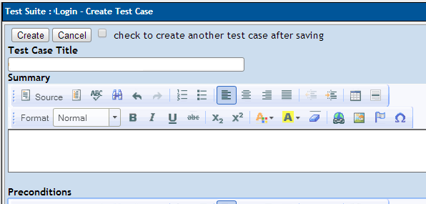
Most basic test case
Test cases

Slide 57
Entering results
Fails half the time, see jira:

Slide 58
Organization
Test plan
Test Suite
Tests
Results are by build

Slide 59
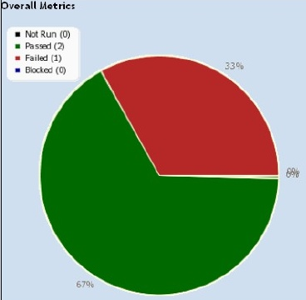

Slide 60
Xray for Jira

Slide 61
Organization
Test plan
Test Execution
(e.g. browser) of test suite
tests

Slide 62
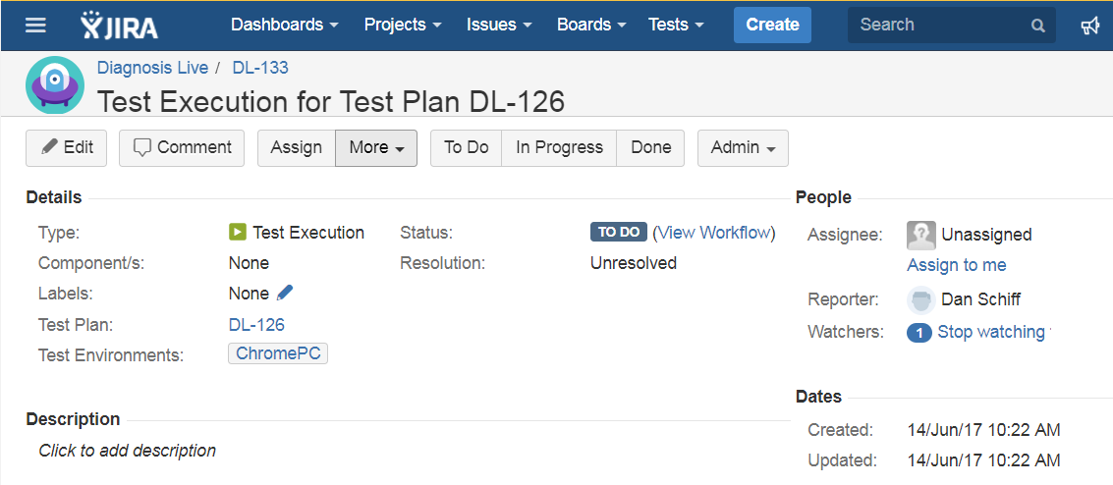

Slide 63
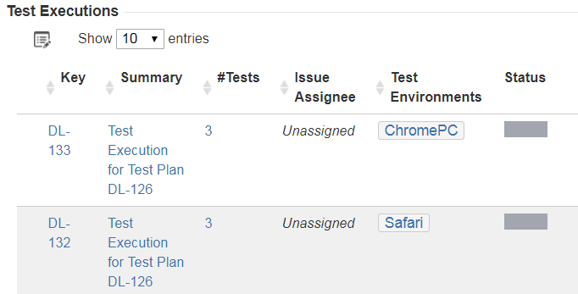

Slide 64
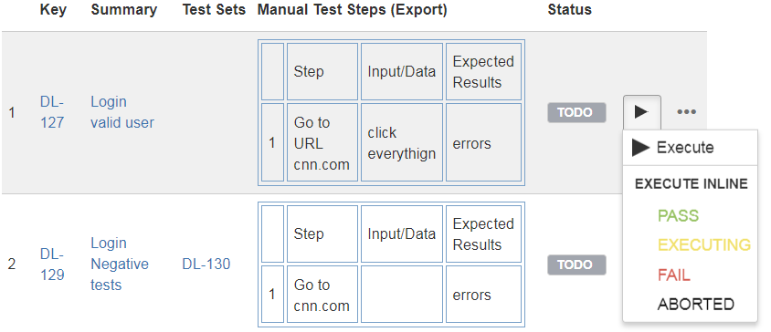

Slide 66
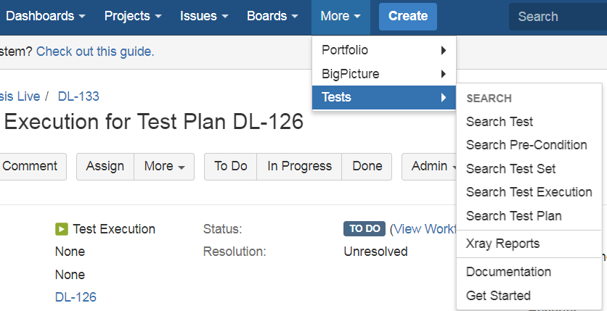
Link from Jira

